Slide 1

Department of Computer Science
University Institute of Engineering
DEPARTMENT OF COMPUTER SCIENCE & ENGINEERING
Bachelor of Engineering
Subject Name: System Programming
Subject Code: CST-315
Compilers
DISCOVER . LEARN . EMPOWER

Slide 2
Chapter-2.1 Compilers
Department of computer Science
Machine Structure
Interfaces
Address Space
Computer Languages

Slide 3
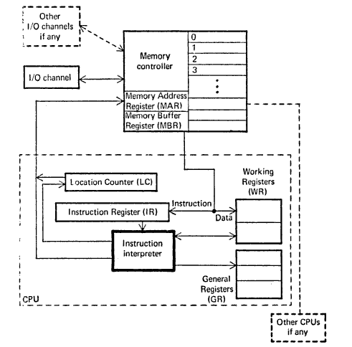
General Machine Structure
The structure of CPU for a typical Von Neumann Machine is as follows –

Slide 4
General Machine Structure
The structure of CPU for a typical Von Neumann Machine is as follows –
The structure above consists of - 1. Instruction Interpreter 2. Location Counter 3. Instruction Register 4. Working Registers 5. General Register

Slide 5
General Machine Structure
The components of a general machine are as follows:
Instruction interpreter: A group of electronic circuits performs the intent of instruction of fetched from memory.
Location counter: LC otherwise called as program counter PC or instruction counter IC, is a hardware memory device which denotes the location of the current instruction being executed.
Instruction register: A copy of the content of the LC is stored in IR.
Working register: are the memory devices that serve as “scratch pad” for the instruction interpreter.
General register: are used by programmers as storage locations and for special functions.
This CPU interfaces with Memory through MAR & MBR The role of I/O Channels is to input or output information from memory.

Slide 6
General Machine Structure
Memory address register (MAR): contains the address of the memory location that is to read from or stored into.
Memory buffer register (MBR): contain a copy of the content of the memory location whose address is stored in MAR. The primary interface between the memory and the CPU is through memory buffer register.
Memory controller: is a hardware device whose work is to transfer the content of the MBR to the core memory location whose address is stored in MAR.
I/O channels: may be thought of as separate computers which interprets special instructions for inputting and outputting information from the memory.

Slide 7
General Machine Structure
To illustrate how these components of machine structure interact, let us take a
command ADD 2,176.
This instruction has three parts first the opcode i.e. ADD,
Second is the number of the register that contain the first operand.
Third is the memory location address that contain the second operand.
• At first, the address from the IC is copied to the MAR.
• Then the instruction is fetched to the MBR.
• The instruction is then transferred to the IR.
Now the first operand is placed in the WR.
• Finally the sum of WR and MBR is calculated and the stored in WR.
• The content of WR is stored to the register that contained first operand.
• And then IC is incremented to point to the next instruction.

Slide 8
General Machine Structure
For Programming at machine level, following questions must be answered:
1.Memory: What is the basic unit, size and addressing scheme of memory?
2.Registers: How Many Registers are there? What are their size, function and interrelationship?
3.Data: What types of the data can be handled? How is this data stored?
4.Instructions: What are the classes of instructions on the machine? What are their formats? How are they stored?
5.Special Features : What is the interrupt structure of the machine? What type of protection mechanism is available?

Slide 9
General Machine Structure
Memory
The basic unit of memory in 360 and 370 is a byte (eight bits of information).
It means, each addressable position in memory can contain a byte of information.
There are facilities to operate on contiguous bytes in basic
units. The basic units are as follows:
A smaller unit of memory of size 4 bits is called as nibble.
The size of a 360 memory is upto 2²⁴ bytes.
The addressing of a 360 memory consists of three parts.
Specifically the value of an address equals to value of the offset, plus the
content of the base register, plus the content of the index register.

Slide 10
General Machine Structure
Addressing Scheme: Address = value of an offset + contents of a base register + contents of an index register;

Slide 11
General Machine Structure
Registers
There are a total of 16 general purpose registers of 32 bits each.
In addition there are 4 floating point register of 64 bits each.
It also has a 64 bits program status word (PSW) that contains the value of the location counter, protection information and interrupt status.
The general purpose registers are basically used in arithmetic and logical operations as base registers and helps in address formation.
The general purpose registers also used as scratch pads for the programmers.
Let us take an instruction
A 1, 901 (2,15).
A(opcode)1(operand in register 1),901(offset) (2(index register),15(base register))

Slide 12
Interface
Interface may be defined in two ways-
1. As per the software ,Interface is a program that allows a user to interact computers in person or over a network. An interface may also refer to controls used in a program that allow the user to interact with the program.
For Eg.
GUI (Graphical User Interface). This type of interface is what you are using now to navigate your computer and how you got to this page.

Slide 13
Interface
2. As per the hardware interface is a physical device, port, or connection that interacts with the computer or other hardware device
For eg.
IDE and SATA are disk drive interfaces for computer Hard Drives and ATAPI is an early interface for CD-ROM drives.
Examples of drive interfaces
The following list is a list of different internal and external interfaces that connect a drive to a computer.
ATA ATAPI, eSATA, FireWire , IDE etc

Slide 14
Address Space
An address space is a range of valid addresses in memory that are available for a program or process. That is, it is the memory that a program or process can access. The memory can be either physical or virtual and is used for executing instructions and storing data.
On a computer, each process and device is allocated an address space, which holds a certain portion of the processor's address space. The processor's address space is typically restricted to the width of its registers and address bus.

Slide 15
Address Space
Address space is often classified as :
flat : In this the addresses are represented as incrementally increasing integers that start at zero
Segmented : In this the addresses are portrayed as independent segments augmented by offsets.
The size of an address space can be made larger than that of physical memory by using a memory management technique called virtual memory.
So an address space consists of both physical memory and virtual memory.

Slide 16
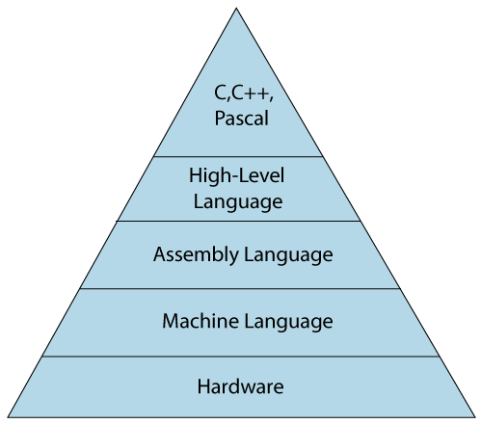
Computer Languages
The computer language is defined as code or syntax which is used to write programs or any specific applications. It is used to communicate with computers.
Computer languages can be broadly classified into
3 major categories :
1. assembly language
2. machine language
3. High-level language.

Slide 17
Types of Computer Languages
1. Machine Language
The machine language is sometimes referred to as machine code or object code which is a set of binary digits 0 and 1. These binary digits are understood and read by a computer system and interpreted easily. It is considered a native language as it can be directly understood by a central processing unit (CPU).
Example of machine language for the text “Hello World”:-
01001000 0110101 01101100 01101100 01101111 00100000 01010111 01101111 01110010 01101100 01100100

Slide 18
Assembly Language
The assembly language is considered a low-level language for microprocessors and many other programmable devices. The assembly language is also considered a second-generation language. The assembly language is mostly famous for writing an operating system and also in writing different desktop applications.
This language has certain drawbacks as
- It does not contain any variables or functions in programs and also
the program is not portable on different processors.
For Eg. ADD A,B -To add the contents of register A & B.

Slide 19
High-Level Language
The high-level language is easy to understand and the code can be written easily as the programs written are user-friendly in a high-level language. The high-level of language uses the concept of abstraction and also focuses on programming language rather than focusing on computer hardware components .
Examples of high-level languages are C++, C, JAVA, FORTRAN, Pascal, Perl, Ruby, and Visual Basic.
Advantages:
The syntax used and the programming style can be easily understood by humans if it is compared to low-level language.
The only requirement in a high-level language is the need for a compiler. As the program written in a high-level language is not directly understood by the computer system.

Slide 20
High Level Language
Computer Languages In-Demand
The list of computer languages is never-ending. From time to time the demand for computer languages also fluctuates. Some languages were in demand years ago but as technology changes the demand also changes. Here is the list of computer languages in demand all around the world:
Ruby
JavaScript
Python
PHP
Java
C#
Objective-C & Swift

Slide 21
References
Department of computer Science
[PDF] Systems Programming and Operating Systems by Dhamdhere - Free Download PDF (dlscrib.com)
[PDF] Principles of Compiler Design By Alfred V. Aho & J.D.Ullman Free Download – Learnengineering.in

Slide 22
THANK YOU

